Slide 1
INSYST Update Effective: 02/22/2017 Be sure to note if instructions are for MHS or SUD services or both.
Client Registration
New MHS field: Veteran Status
Episode Open and Closing:
MHS & SUD- Ability to enter ICD-10 Diagnosis Codes
MHS – New Field for General Medical Code (GMC)
MHS – Nurse Practitioner allowed in the Physicians field
MHS – Only a selected group of Programs will be using the new PEI (Prevention and Early Intervention) screens.

Slide 2
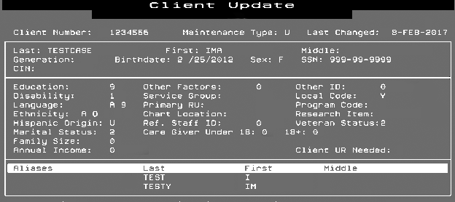
Client Registration
New mandatory MHS fields are included during the Client registration
VETERANS STATUS:
Valid values are numeric:
1 - Yes
2 – No
3 - Declined to answer.

Slide 3
Episode Open and Closing: MHS & SUD- Ability to enter ICD-10 Diagnosis Codes
Providers may continue to using DSM-IV to crosswalk the primary diagnosis to the ICD-10 diagnosis code through March 31, 2017.
Effective April 1, 2017, and as early as 2/22/17, begin using the new ICD-10 InSyst fields according to information stated in the Quality Assurance Memo dated February 22, 2017.

Slide 4
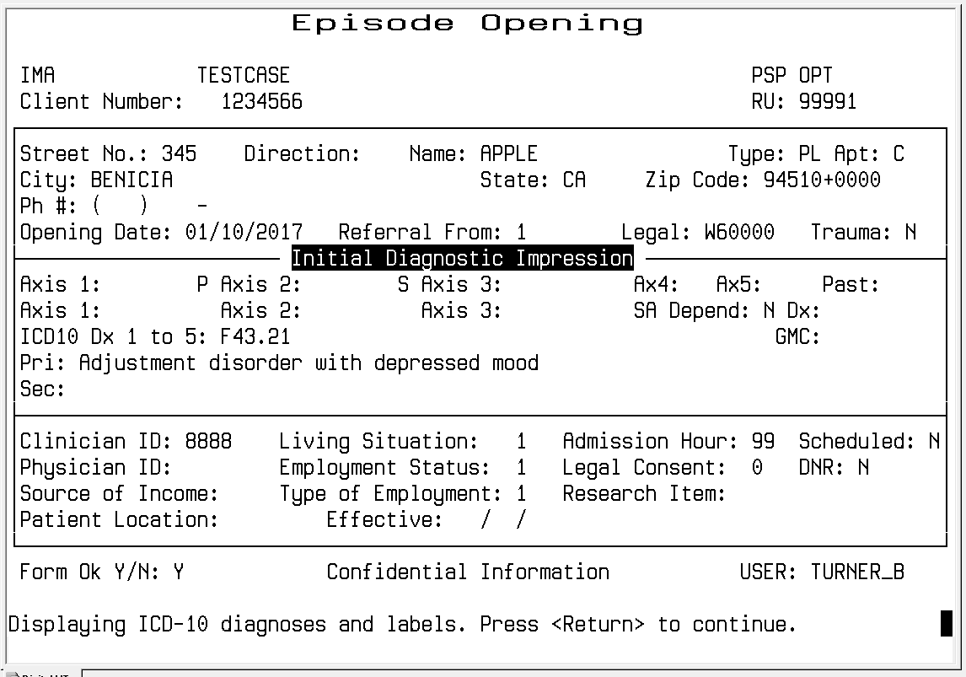
MHS Episode Open / Closing: Ability to enter ICD-10 Diagnosis Codes
New ICD10 diagnoses codes fields:
Primary and Secondary fields accept valid “Included” ICD-10 Behavioral Health (“F” series as well as “No Diagnosis” or “Deferred Diagnosis”) diagnosis codes.
The Third, Fourth, and Fifth fields accepts either Behavioral Health (Included or Excluded ) or Physical Health diagnosis codes.
Additional ICD-10 description labels for the Primary and Secondary ICD-10 diagnosis code will then be listed.

Slide 5
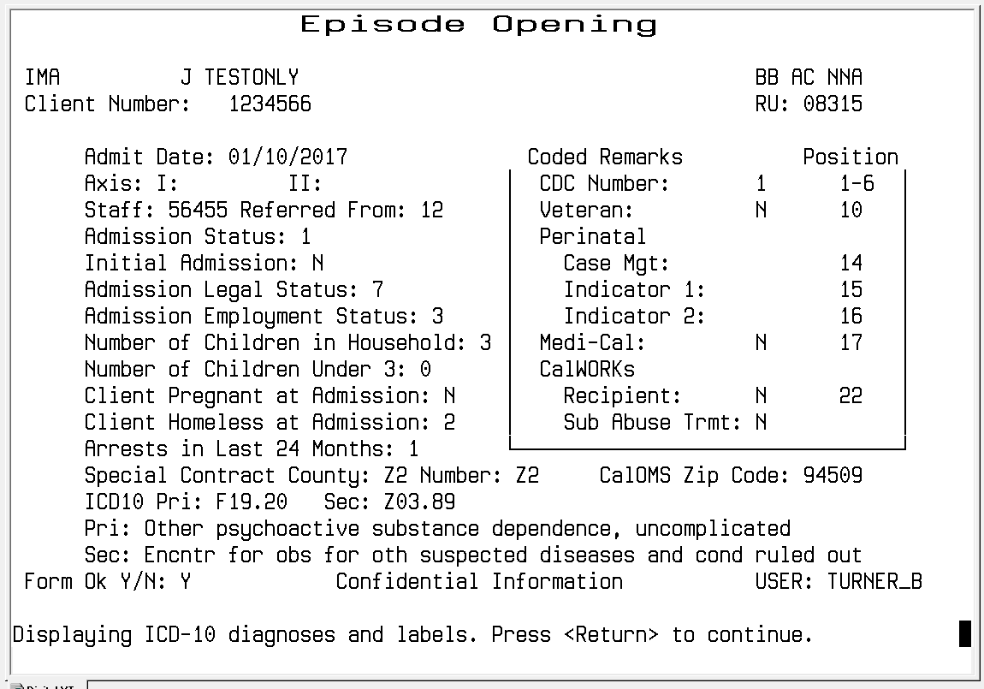
Episode Open and Closing: SUD- Ability to enter ICD-10 Diagnosis Codes
New ICD10 diagnoses codes fields:
Primary and Secondary fields accept valid ICD-10 diagnosis codes (F10-F19)
Additional ICD-10 description labels for the Primary and Secondary ICD-10 diagnosis code.

Slide 6
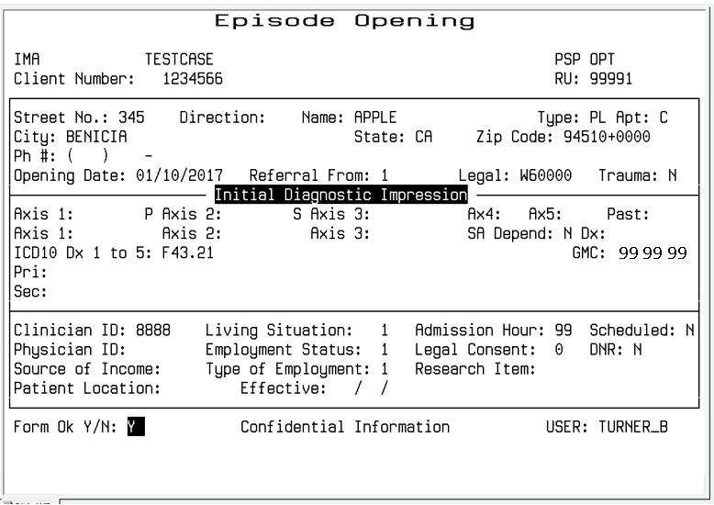
MHS Episode Open /Closing: New Field for General Medical Code (GMC)
3 new GMC codes fields. Standard GMC codes still apply (see list).
GMC code values located on the Providers Website under the InSyst Menu / Forms.
Link to the General Medical Condition Summary Codes displayed by code
Axis’ 1 – 3 are no longer available effective 4/1/17. Continue to enter the Principal Psychological and/or Environmental A- J Codes in Axis IV, and the GAF score in the Axis 5 field as well as in the appropriate CSI field.

Slide 7
MHS Episode Open / Closing: Nurse Practitioner allowed in the Physicians field
Nurse Practitioner (and Physician Assistants) allowed in the Physicians field

Slide 8
MHS PEI Screens
Training will be provided at a later date for the Programs that will be using this new screens to collect PEI data as required by the State.
If you wish further information regarding the PEI screen please contact the Help Desk at (510) 567-8181

Slide 9
Contact Information
Information Systems Help Desk:
InSyst Data Entry/ Staff # Assistance
& InSyst Reports: (510) 567-8181
InSyst Data Entry Training:
Helpdesk (510) 567-8181
Willie Chu (510) 383-1591
Quality Assurance:
DSM-5 & ICD-10 related coding and medical records documentation questions: see attached QA Contact List

